Slide 1
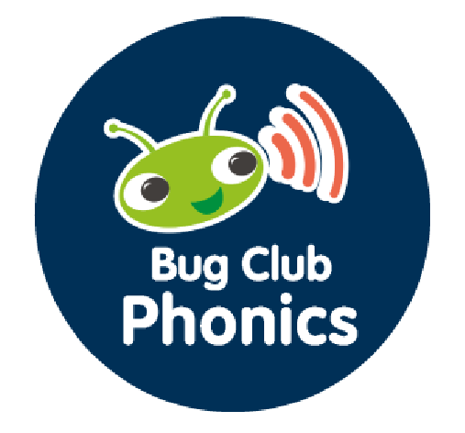
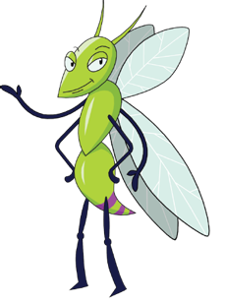




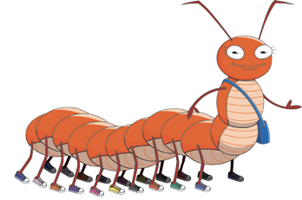

Bug Club Phonics
Decodable Readers
Build children’s confidence at the
very start of their reading journey.
Bug Club Phonics Decodable Readers give children opportunities to practice their blending skills and consolidate their knowledge of letter-sound correspondences in the context of engaging texts.
NEW
CANADIAN
EDITION

Slide 2
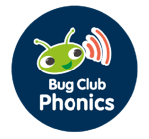
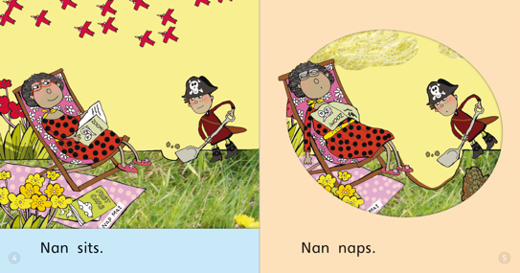
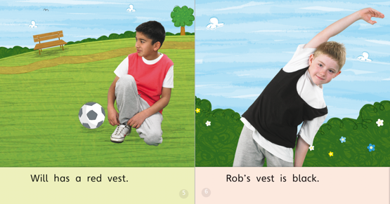


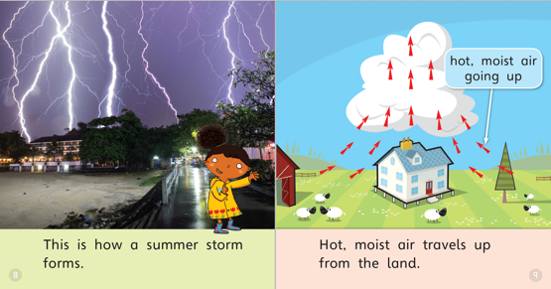
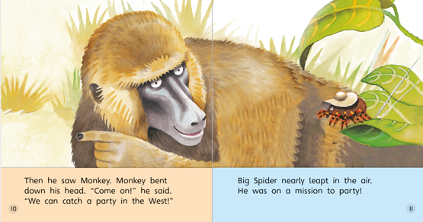

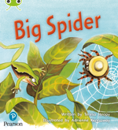

100% Decodable
Decodable books are an integral part of any phonics program, providing opportunities to practice phonics skills. Bug Club Phonics Decodable Readers offer fiction and nonfiction books with a range of characters and themes to appeal to every child.
131 titles spread across a full scope and sequence!
Set 02
Set 06
Set 15
Set 27
There so much more to explore! ● pearsoncanada.ca/BCP ● Pricing and Order Information ● Virtual Samples

Slide 3
Scope and Sequence
Bug Club Phonics Decodable Readers are organized into sets with each set focusing on particular
letter-sound correspondences. Simpler, more common patterns are addressed first and more complex, less frequent patterns are addressed when easier skills are mastered.
PHASE 1: Phonemic Awareness Develop listening skills, awareness of sounds Develop awareness of rhythm and rhyme in speech Develop oral blending and segmenting of sounds in words
Set | Letter/Sound Correspondences
01 | Wordless Books
PHASE 3: Basic Phonemes (Part 2) Teach more letter-sound correspondences, most with two letters Practice CVC blending and segmentation Apply knowledge of blending and segmenting to reading and spelling simple two-syllable words and captions
Set | Letter/Sound Correspondences
06 | j, v, w, x
07 | y, z, zz, qu
08 | ch, sh, th, ng
09 | ai, ee, igh, oa, oo (long), oo (short)
10 | ar, or, ur, ow, oi
11 | ear, air, ure, er
PHASE 5: Alternate Spellings Teach alternative pronunciations for graphemes students already know
Set | Letter/Sound Correspondences
13 | wh, ph
14 | ay, a-e, eigh/ey/ei (long a)
15 | ea, e-e, ie/ey/y (long e)
16 | ie, i-e, y, i (long i)
17 | ow, o-e, o/oe (long o)
18 | ew, ue, u-e (long o), u/oul (short oo)
19 | aw, au, al
20 | ir, er, ear
21 | ou, oy
22 | ere/eer, are/ear
23 | c, k, ck, ch
24 | c(e) / c(i) / c(y), sc/st(l), se
25 | g(e) / g(i) / g(y), dge
26 | le, mb, kn/gn, wr
27 | tch, sh, ea, zh, (w)a, o
PHASE 2: Basic Phonemes (Part 1) Begin with the most common letters-sound correspondences Move from oral blending and segmentation to blending and segmenting with letters Introduce VC and CVC words and practice spelling them Introduce two-syllable words, simple captions
Set | Letter/Sound Correspondences
02 | s, a, t, p, i, n, m, d
03 | g, o, c, k
04 | ck, e, u, r
05 | h, b, f, ff, l, ll, ss
PHASE 4: Consolidation Consolidate knowledge of graphemes in reading and spelling words containing adjacent consonants and polysyllabic words
Set | Letter/Sound Correspondences
12 | Adjacent consonants (cvcc, ccvc, ccvcc, cccvc, cccvcc)
There so much more to explore! ● pearsoncanada.ca/BCP ● Pricing and Order Information ● Virtual Samples

Slide 4
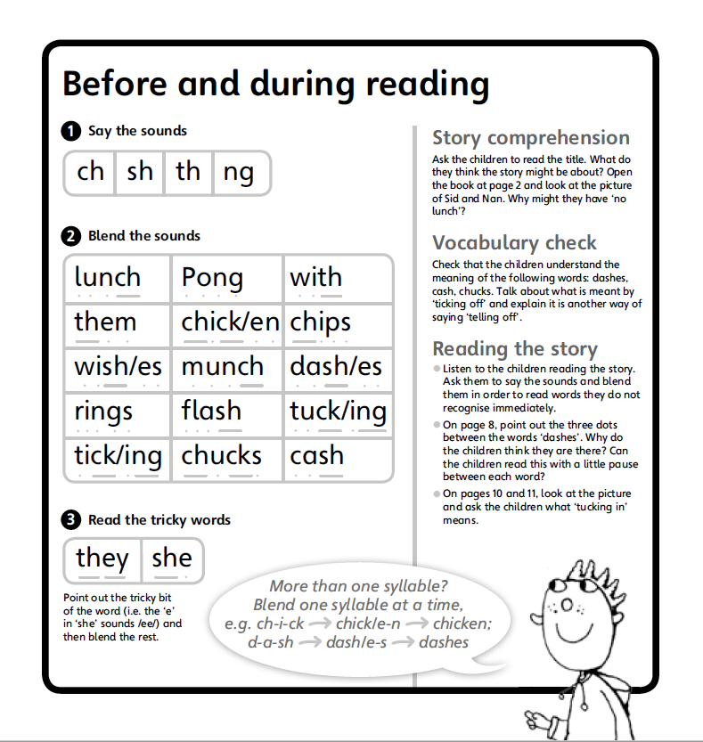
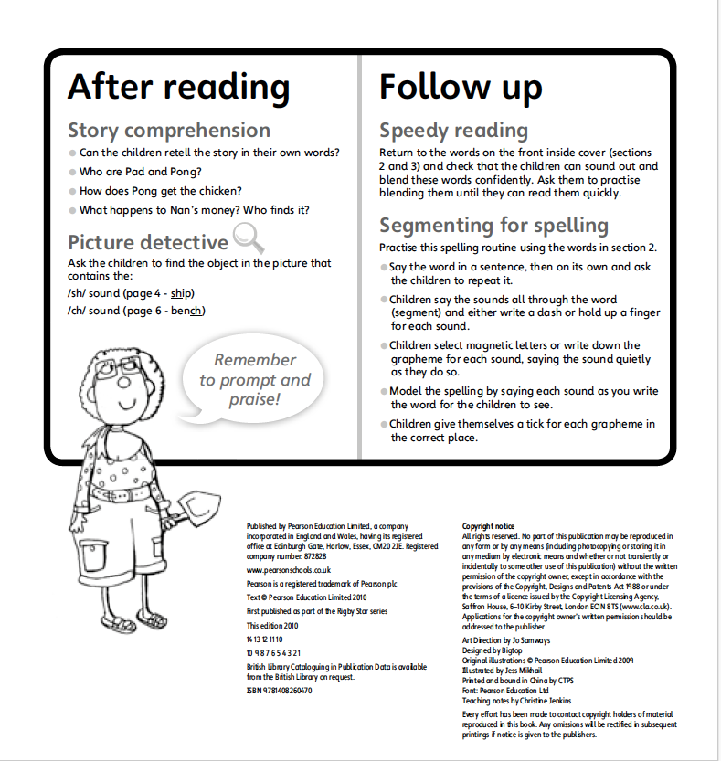
Teaching Notes
Each book features inside cover notes and tips on how to share books effectively, identifying the phonic focus and possible extension activities.
Introduces the phonemes for the book and encourages children to say each word.
Suggests questions to develop understanding. Deductive and inferential questions are included where appropriate.
Encourages children to read the phonemes again to promote practice and fluency.
Highlights the words containing phonemes so children can practice blending the sounds prior to reading.
There so much more to explore! ● pearsoncanada.ca/BCP ● Pricing and Order Information ● Virtual Samples

Slide 5

Pearson Canada has developed Canadian edition!
Bug Club Phonics Decodable Readers were originally published by Pearson UK and included some British words or references in some of the books. Our Pearson Canada team has reviewed each book and revised all British content to make the series appropriate for Canadian teachers and students. And we added 8 new Canadian-authored books!
Bug Club Phonics Decodable Readers are available in the following packs:
Complete Series (Phases 1-5) |  | Phase 2 (Kindergarten) |  | Phase 4 (Grades K-1)
BCP Complete Series: Classroom Pack (786 books: 131 titles, 6 copies each) BCP Compete Series: Add-on Pack (131 books: 131 titles, 1 copy each) |  | BCP Phase 2: Classroom Pack (132 books: 22 titles, 6 copies each) BCP Phase 2: Add-on Pack (22 books: 22 titles, 1 copy each) |  | BCP Phase 4: Classroom Pack (144 books: 24 titles, 6 copies each) BCP Phase 4: Add-on Pack (24 books: 24 titles, 1 copy each)
Phase 1 (Kindergarten) |  | Phase 3 (Grades K-1) |  | Phase 5 (Grades 1-2)
BCP Phase 1: Classroom Pack (24 books: 4 titles, 6 copies each) BCP Phase 1: Add-on Pack (4 books: 4 titles, 1 copy each) |  | BCP Phase 3: Classroom Pack (210 books: 35 titles, 6 copies each) BCP Phase 3: Add-on Pack (35 books: 35 titles, 1 copy each) |  | BCP Phase 5: Classroom Pack (276 books: 46 titles, 6 copies each) BCP Phase 5: Add-on Pack (46 books: 46 titles, 1 copy
ATTENTION: Customers who purchased the Bug Club Phonics Release Packs in 2022
If you are looking to complete your Bug Club Phonics implementation with the purchase of subsequent Release Packs, they are still available for a limited time. Contact your Pearson Representative for order information.
There so much more to explore! ● pearsoncanada.ca/BCP ● Pricing and Order Information ● Virtual Samples

Slide 6






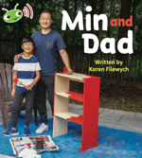







Overview of Titles
Phase 1 | Set 00: Wordless Books
Phase 2 | Set 01-02: s, a, t, p, i, n, m, d
Phase 2 | Set 03: g, o, c, k High-frequency Words: to
Decodability: All words are decodable with the exception of a few common irregular (‘tricky’) words needed to make the text meaningful. Some books contain environmental print which is often above the reading level of the child, but you can decide whether or not to draw attention to this text.
There so much more to explore! ● pearsoncanada.ca/BCP ● Pricing and Order Information ● Virtual Samples

Slide 7
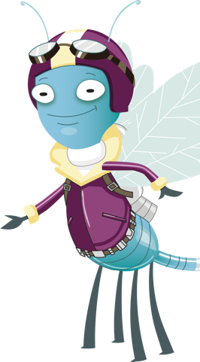


















Overview of Titles
Phase 2 | Set 04: ck, e, u, r High-frequency Words: the, no, go
Phase 2 | Set 05: h, b, f, ff, l, ll, ss High-frequency Words: I, into, her
 | Phase 3 | Set 06: j, v, w, x High-frequency Words: me, be
There so much more to explore! ● pearsoncanada.ca/BCP ● Pricing and Order Information ● Virtual Samples

Slide 8


















Overview of Titles
Phase 3 | Set 07: y, z, zz, qu High-frequency Words: he, she, my, by
Phase 3 | Set 08: ch, sh, th, ng High-frequency Words: they
Phase 3 | Set 09: ai, ee, igh, oa, oo (long), oo (short) High-frequency Words: we, are
Plurals and 3rd Person Verbs: Simple plurals and ‘s’ forms of verbs are used from the start as they are extremely common and research indicates that they d not pose problems for most children.
There so much more to explore! ● pearsoncanada.ca/BCP ● Pricing and Order Information ● Virtual Samples

Slide 9
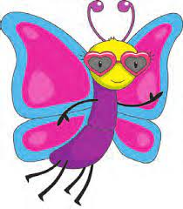









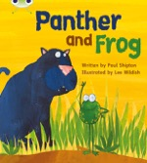

Overview of Titles
Phase 3 | Set 10: ar, or, ur, ow, oi High-frequency Words: you
 | Phase 3 | Set 11: ear, air, ure, er High-frequency Words: all, was, give, live
Sentence Level Progression: In addition to the cumulative coverage of grapheme−phoneme correspondence, Bug Club Phonics readers gradually move from captions in the earliest books, through to simple sentences and more complex sentence structures in the later ones. There is also a carefully planned gradual increase in the number of words and the number of different words at each level. The stories themselves also become generally more sophisticated at later levels, while maintaining their appropriateness for the age group.
There so much more to explore! ● pearsoncanada.ca/BCP ● Pricing and Order Information ● Virtual Samples

Slide 10












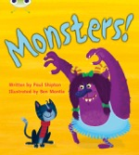











Overview of Titles
Phase 4 | Set 12: Adjacent consonants (cvcc, ccvc, ccvcc, cccvc, cccvcc) High-frequency Words: said, have, like, so, do, some, come, were, there, one, when, out, what
There so much more to explore! ● pearsoncanada.ca/BCP ● Pricing and Order Information ● Virtual Samples

Slide 11













Overview of Titles
Phase 5 | Set 13: wh, ph High-frequency Words: oh, their, people
Phase 5 | Set 14: ay, a-e, eigh/ey/ei (long a) High-frequency Words: Mr, Mrs, Ms
Phase 5 | Set 15: ea,e-e, ie/ey/y (long e) High-frequency Words: looked, called, ask
Polysyllabic Words: Simple polysyllabic words (words with two syllables or more) are introduced from Set 5. These words are given special attention in the teaching notes. Children sometimes have problems with polysyllabic words as they have to break down the word into its component syllables, before blending each one and then combining them to read the whole word.
There so much more to explore! ● pearsoncanada.ca/BCP ● Pricing and Order Information ● Virtual Samples

Slide 12










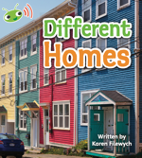









Overview of Titles
Phase 5 | Set 16: ie, i-e, y, i (long i) High-frequency Words: water, where
Phase 5 | Set 17: ow, o-e, o/oe (long o) High-frequency Words: who, again
Phase 5 | Set 18: long u: ew, ue, u-e; long o: u/oul (short oo) High-frequency Words: thought, through
Phase 5 | Set 19: aw, au, al High-frequency Words: work, laugh, because
Phase 5 | Set 20: ir, er, ear High-frequency Words: Thursday, Saturday, thirteen, thirty | Set 20 Alternate Spellings: ir, er, ear High-frequency Words: Thursday, Saturday, thirteen, thirty
Phase 5 | Set 21: ou, oy High-frequency Words: different, any, many
There so much more to explore! ● pearsoncanada.ca/BCP ● Pricing and Order Information ● Virtual Samples

Slide 13









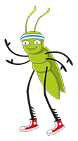





Overview of Titles
Phase 5 | Set 22: ere/eer, are/ear High-frequency Words: eyes, friends |  |  |  | Phase 5 | Set 25: g(e) / g(i) / g(y), dge High-frequency Words: it’s, I’m, I’ll, I’ve
Phase 5 | Set 23: c, k, ck, ch High-frequency Words: two, once |  |  |  | Phase 5 | Set 26: ie, mb, kn/gn, wr High-Frequency Words: don’t, can’t, didn’t
Phase 5 | Set 24: c(e), c(i), c(y), sc, st(l), se High-frequency Words: great, clothes |  |  |  | Phase 5 | Set 27: tch, sh, ea, zh, (w)a, o High-frequency Words: first, second, third
There so much more to explore! ● pearsoncanada.ca/BCP ● Pricing and Order Information ● Virtual Samples

