Slide 1
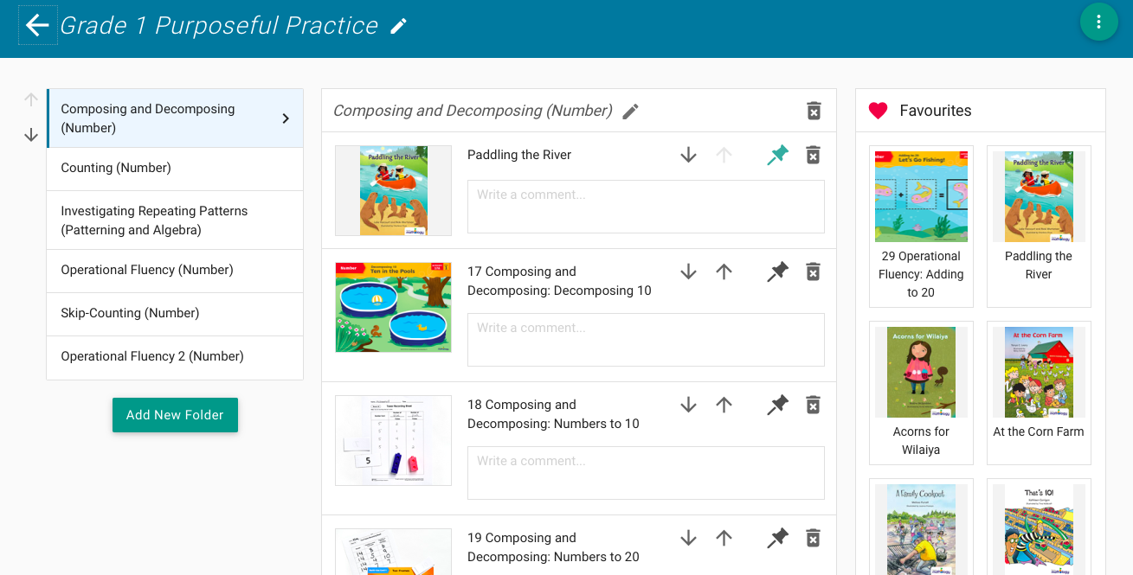
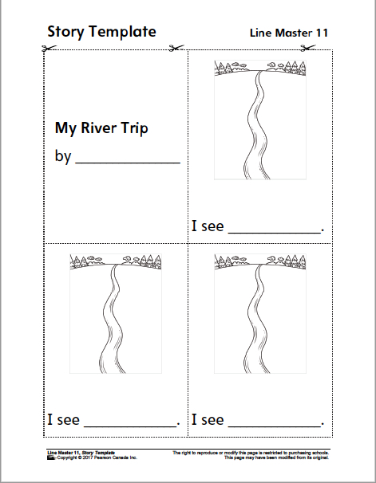
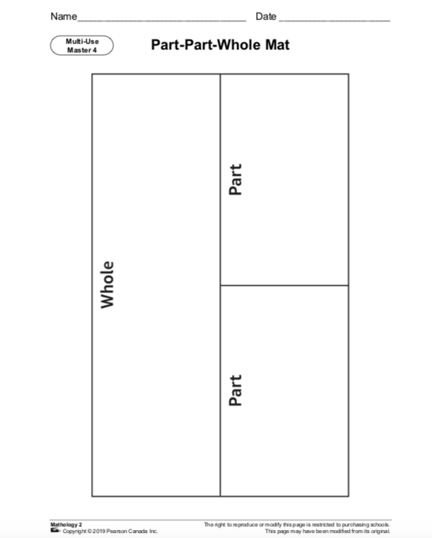
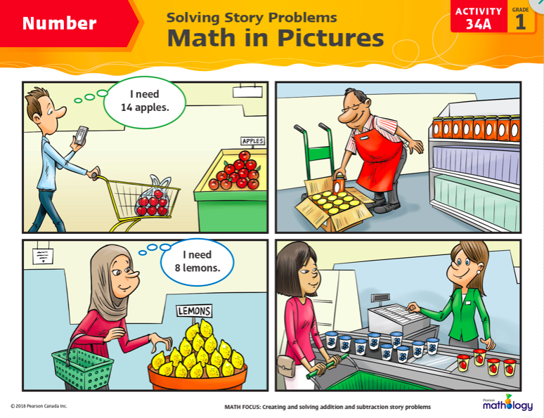
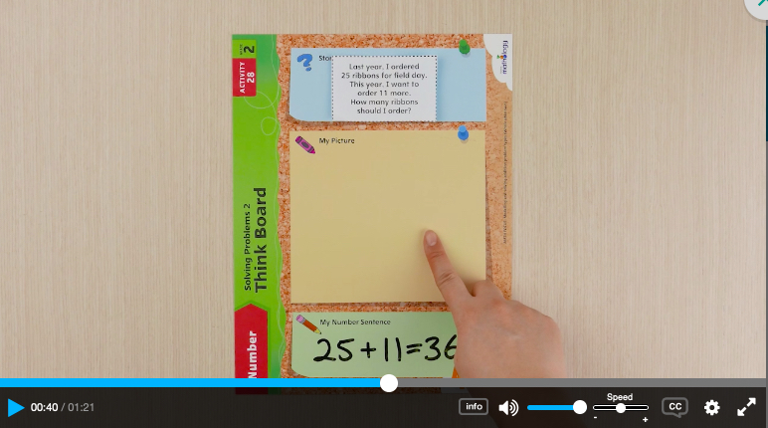
Tip of the Week: Using Mathology.ca For At-Home Learning
Mathology.ca contains carefully-curated K-3 lessons that:
Are Curriculum-focused
Are Engaging
Support Differentiation
Are Perfect for At-home and On-line Use
Provide Short Professional Learning “How-to” Videos to Support Teachers
Read-Aloud Books and Engaging Math Stories
Ready-made Weekly, Monthly and Yearly Lesson Plans
Mathology.ca
Share-able, Editable Worksheets for Extra Practice or to Show What You Know
Fun Activities and Math Games
How-To Videos

Slide 2
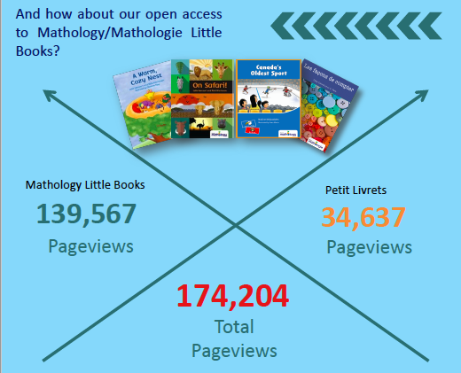
In-class and On-line Learning Support for K-3 Mathematics
During COVID-19 Pearson Canada provided open access to Mathology.ca Canada-wide to support Early Math teaching and learning at a critical time.
Mathology.ca and Mathology Little Books usage soared!
If you haven’t tried Mathology.ca yet: sign up for a free trial here.

