Slide 1
Use Activity Card Silly Snake to estimate and measure the length of objects using different units.
You can use objects found at home to measure the length of the Silly Snake (see Slide #2)
Ask:
How long do you think the snake is? How many ______ long do you think it is?
How close was your prediction?
Why were your counts different when you used different items?

Slide 2
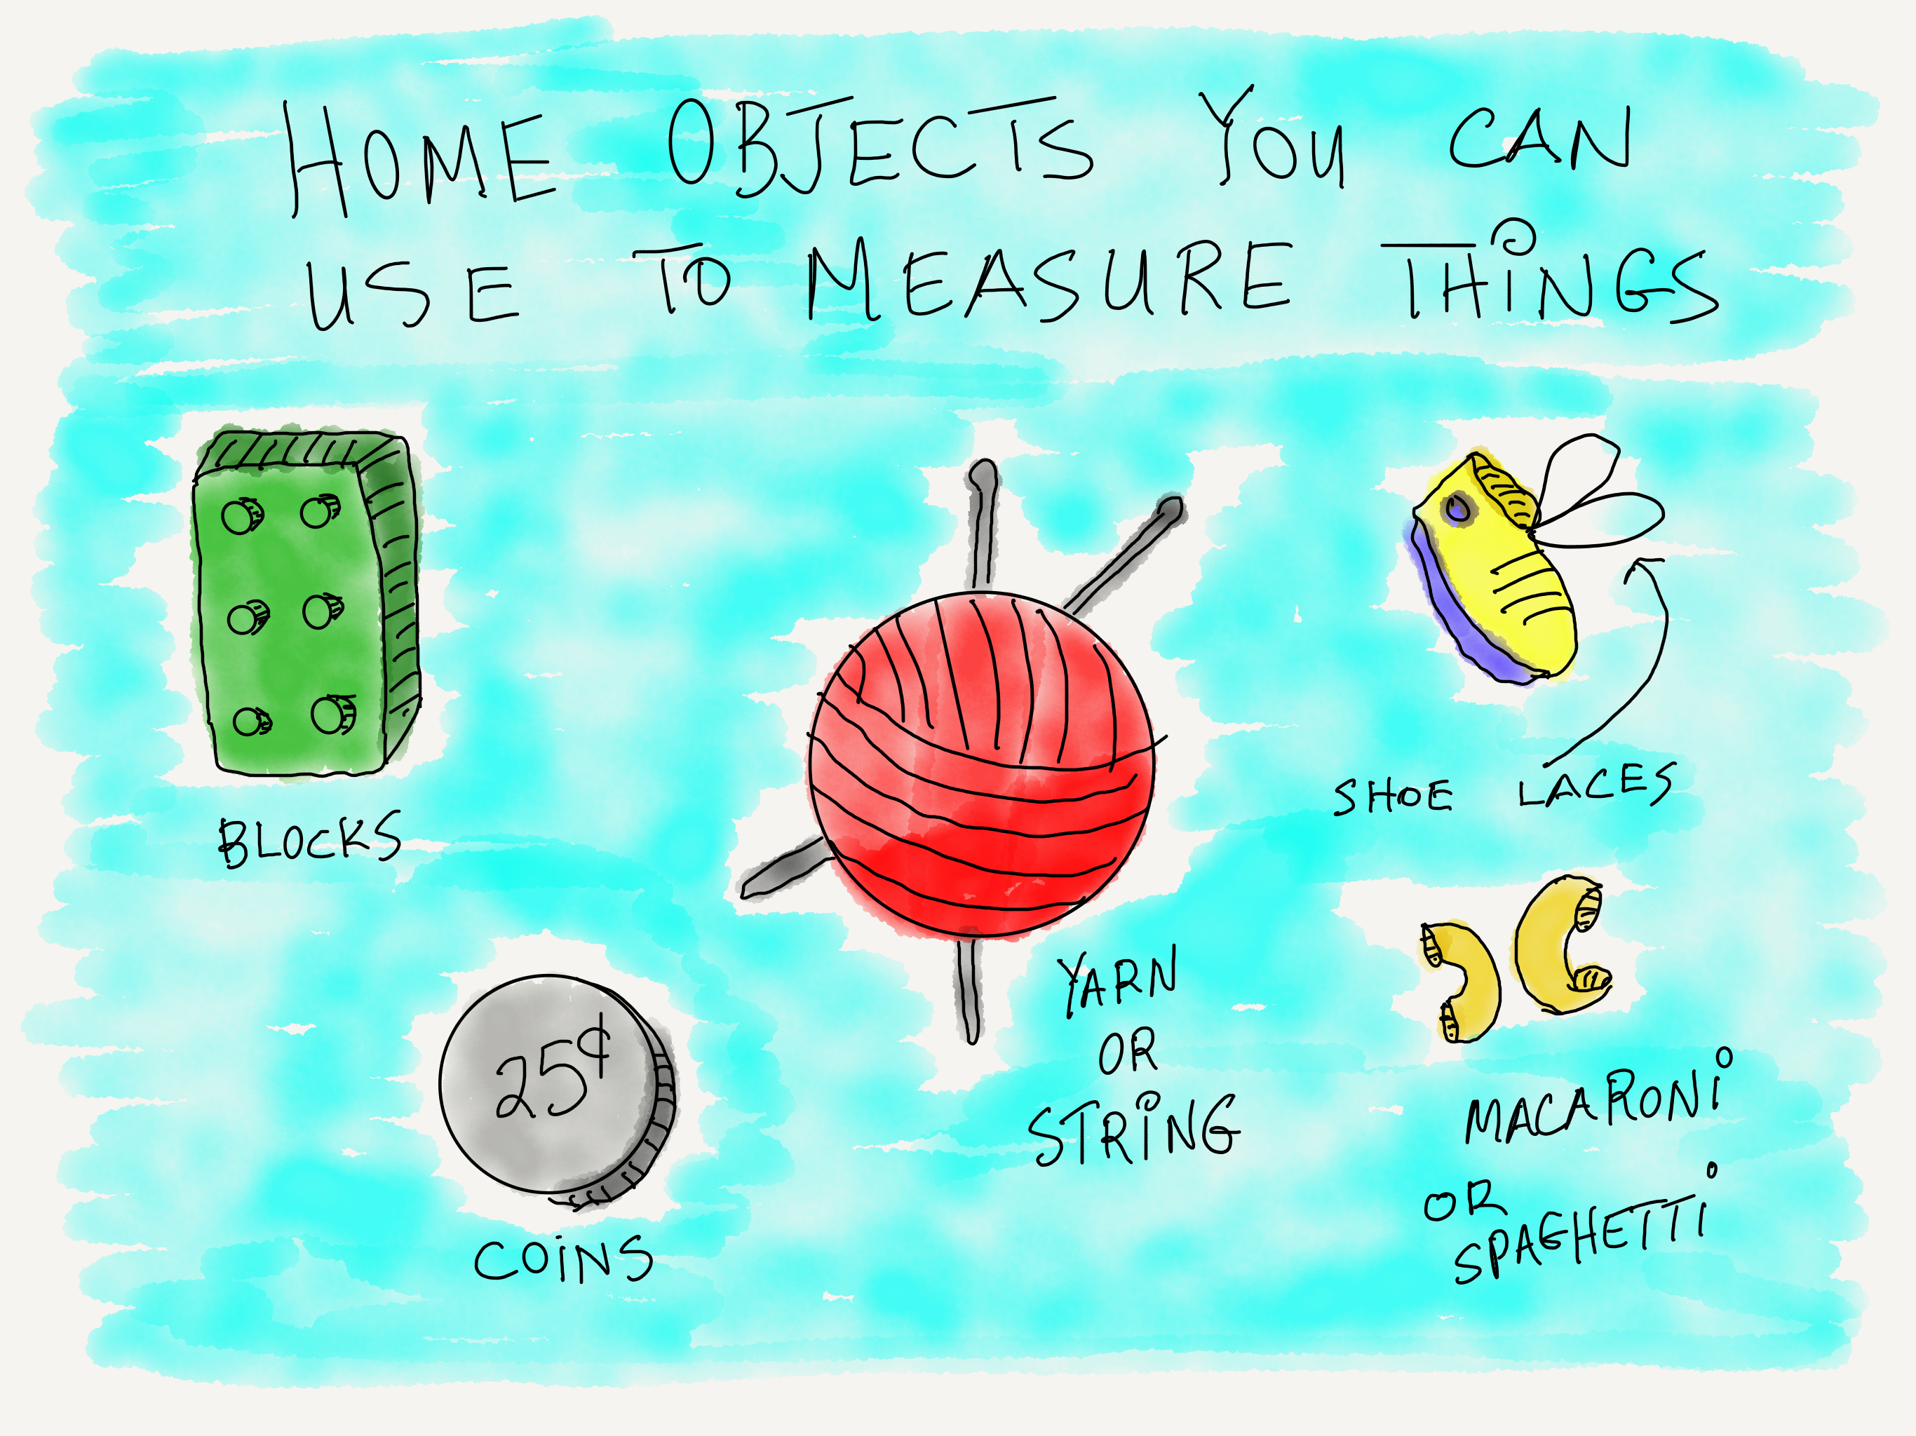
Tip of the Week
Some possible home objects to measure the Silly Snake

