Slide 1
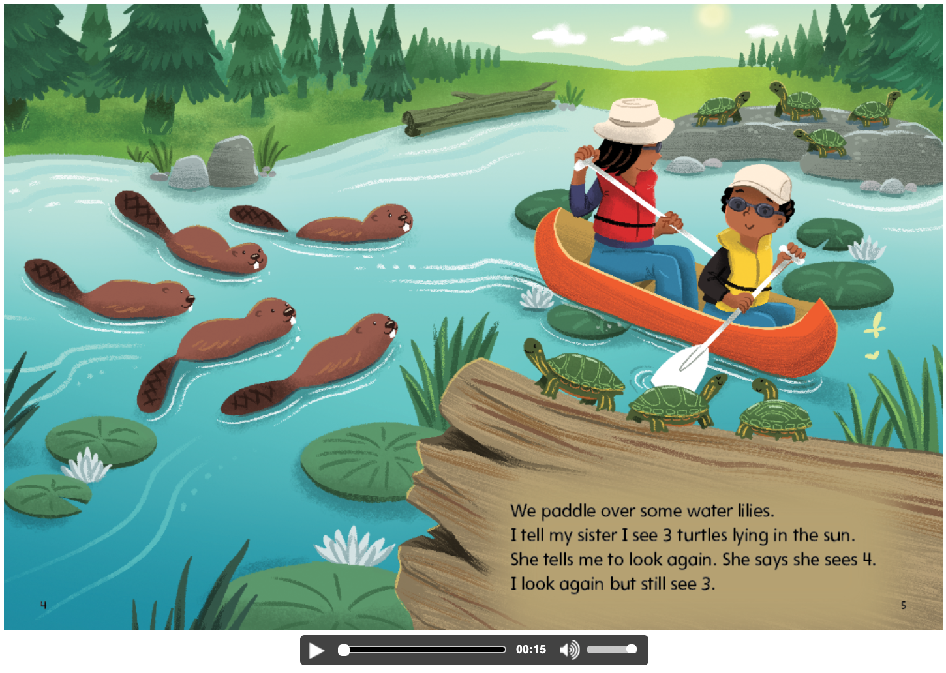
Use the Gr 1 Mathology Little Book to have students count, compare and order to 20.
Ask:
How many turtles do you see?
How many animals do you see? Show how you know.
Are there more turtles or beavers? How many more?

