Slide 1
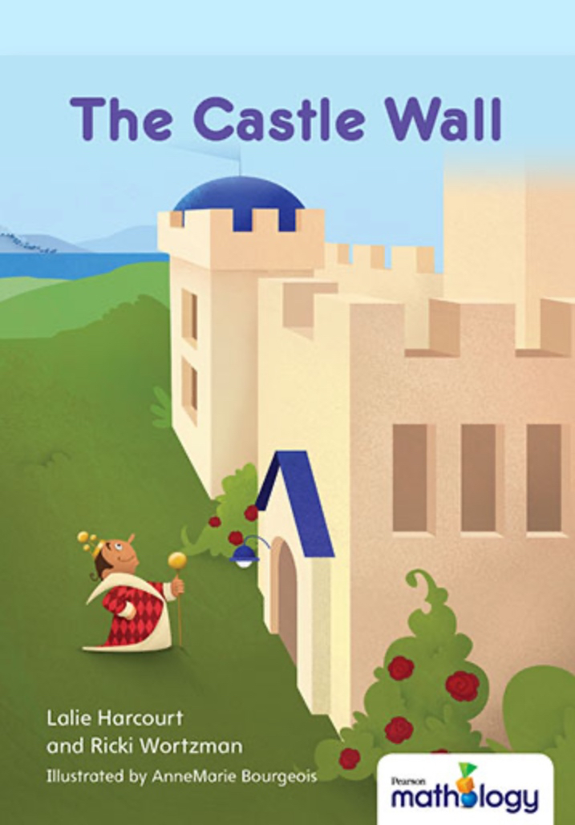
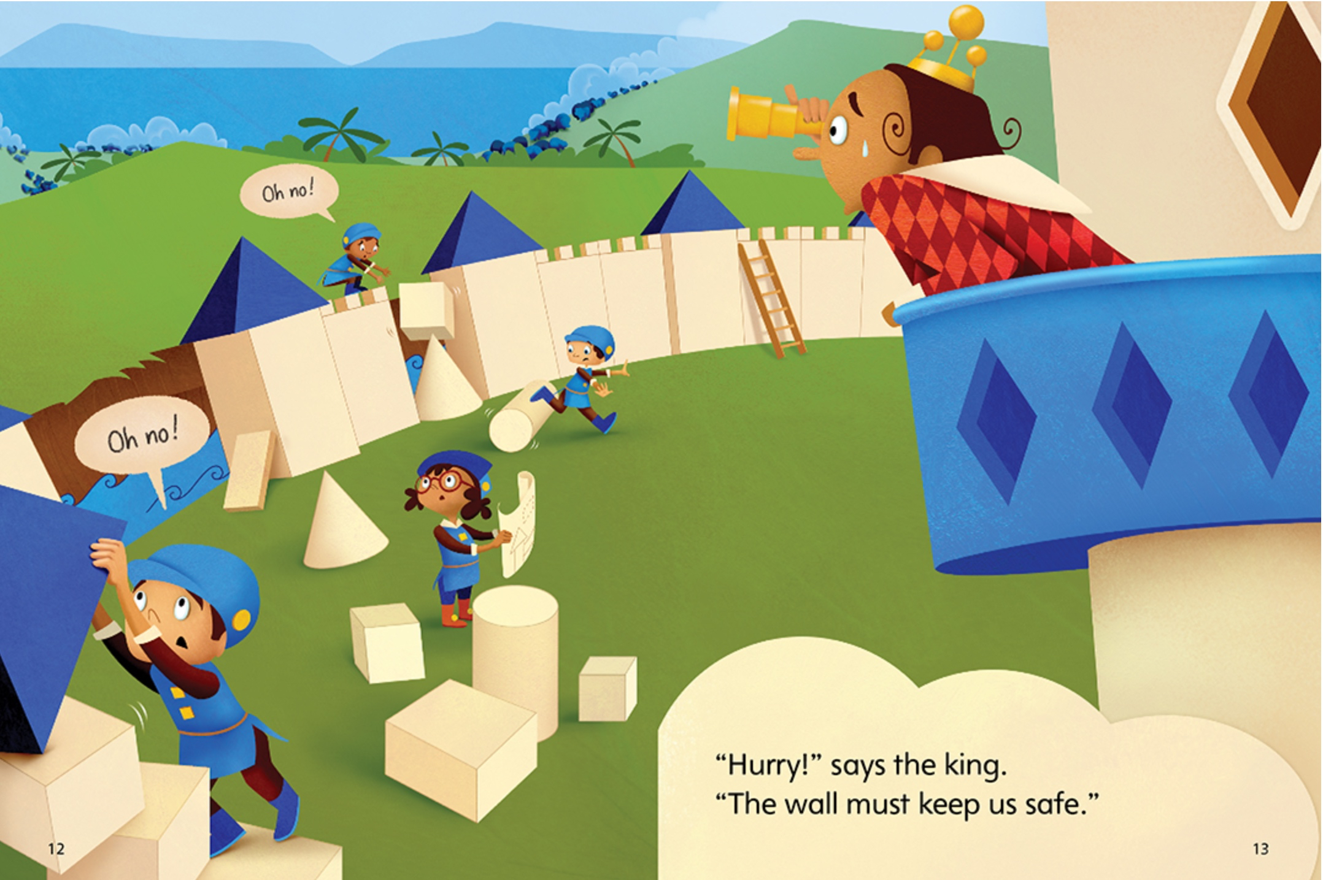
Geometry
Go toThe Castle Wall
Open and download the Parent Info Line Master for lots of ideas to help children learn more about 3-D Structures
Try This Activity:
Build a structure at home out of building blocks, clean recycled packaging, and/or found objects. Discuss which blocks/objects are better for building a sturdy base.

