Slide 1
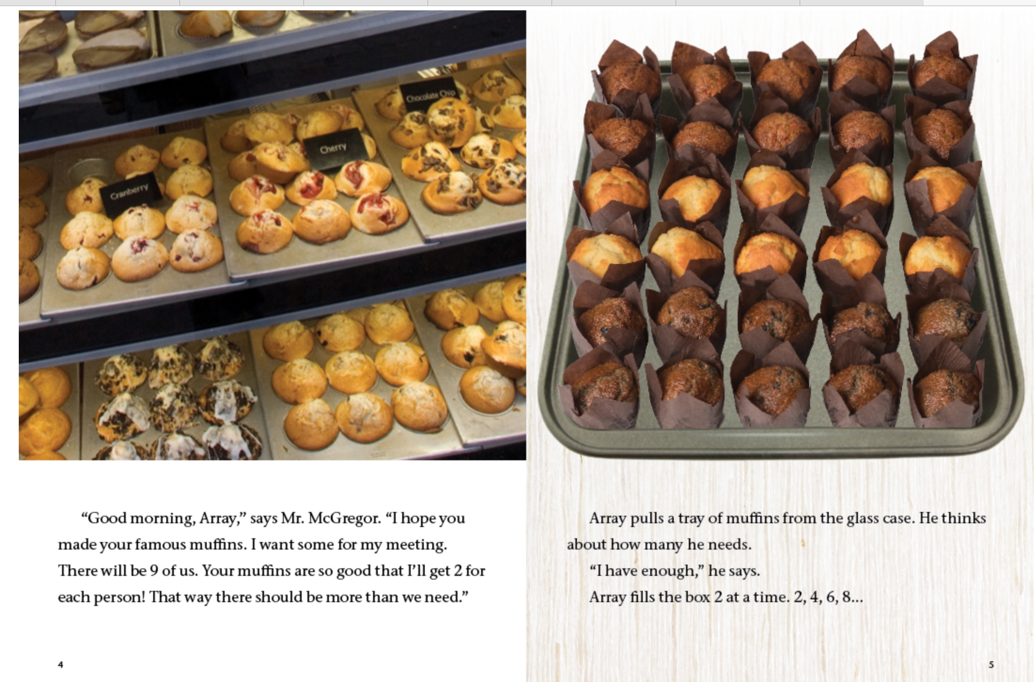

Addition & Subtraction
Go to Array’s Bakery
Use the read-aloud option if you wish.
Turn to pages 4-5 and discuss the following questions:
How are the muffins in each pan arranged?
How would you count the muffins in each pan?
How many muffins do you think Mr. McGregor is ordering?

