Slide 1
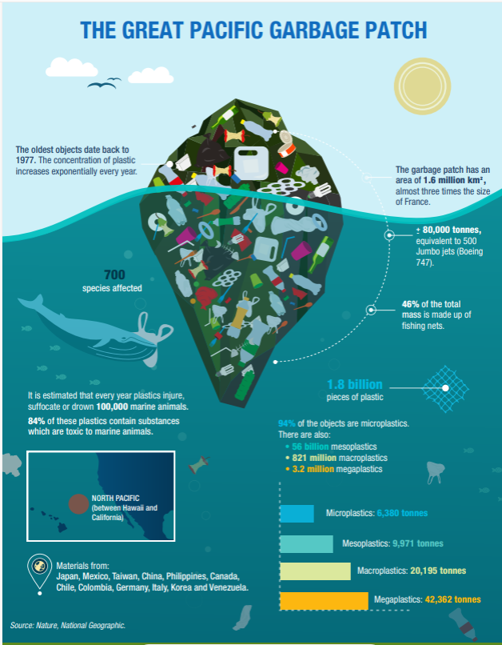
Line Master 1
The world is addicted to plastics!
Look at the infographic.
What do you notice?
What do you wonder?
List 4 different numbers
that you see.
How can you represent
these numbers using
scientific notation involving powers of 10?
The right to reproduce or modify this page is restricted to purchasing schools. This page may have been modified from its original.

Slide 2
Sample Answers
80 000 tonnes = 8.0 × 10⁴ tonnes
1.6 million km² = 1 600 000 km²
= 1.6 × 10⁶ km²
56 billion mesoplastics = 56 000 000 000 mesoplastics
= 5.6 × 10¹⁰ mesoplastics
6380 tonnes microplastics = 6.38 × 10³ tonnes microplastics
The right to reproduce or modify this page is restricted to purchasing schools. This page may have been modified from its original.

Slide 3
Working on It
Did you know…
In a single year, Canadians generate a staggering 4.6 million or 4.6 × 10⁶ metric tonnes of plastic waste?
Source: https://plasticactioncentre.ca/news/inside-torontos-plastic-problem/#:~:text=In%20a%20single%20year%2C%20we,metric%20tonnes%20of%20plastic%20waste
Let’s go on a plastic scavenger hunt!
Research quantities related to plastic waste that can be represented using scientific notation.
Create an infographic to display your findings.
Include numbers represented in standard form
and numbers represented in scientific notation.
The right to reproduce or modify this page is restricted to purchasing schools. This page may have been modified from its original.

Slide 4
Sample Data
About 2.8 million tonnes of plastic waste end up
in Canadian landfills every year. This is equivalent
to the weight of 24 CN towers.
Source: https://oceana.ca/en/blog/canadas-plastic-problem-sorting-fact-fiction/
According to the Canadian government, Canadians use almost 15 billion plastic bags every year and close to
57 million straws every day.
Source: https://oceana.ca/en/blog/canadas-plastic-problem-sorting-fact-fiction/
The right to reproduce or modify this page is restricted to purchasing schools. This page may have been modified from its original.

Slide 5
It takes over 450 years for a single plastic water bottle
to decompose.
Source: https://www.watercanada.net/single-use-plastic-bottle-waste-the-focus-of-new-multi-media-exhibit/#:~:text=That%20equates%20to%20over%20500,the%20Great%20Lakes%20every%20year
Canadians consume approximately 2.5 billion litres
of bottled water that results in 10 000 tonnes of plastics entering the Great Lakes every year.
Source: https://www.watercanada.net/single-use-plastic-bottle-waste-the-focus-of-new-multi-media-exhibit/#:~:text=That%20equates%20to%20over%20500,the%20Great%20Lakes%20every%20year
The right to reproduce or modify this page is restricted to purchasing schools. This page may have been modified from its original.

Slide 6
Reflect and Connect
What did you learn about the magnitude of plastic waste in the world? Explain.
What is something you can do to reduce plastic waste?
What did you learn about working with
really big numbers?
Explain standard form and scientific notation
and describe the differences between them.
How does scientific notation help you to better communicate about very large numbers?
The right to reproduce or modify this page is restricted to purchasing schools. This page may have been modified from its original.

